Slide 1
Neural Networks II
Il-Chul Moon Dept. of Industrial and Systems Engineering KAIST
icmoon@kaist.ac.kr

Slide 2
Structures of Neural Networks

Slide 3
Detour: Multiple Layers of Neural Network
Considering L hidden layers
Neuron input activation function for the k-th layer
$a^{k}\left(x\right)=b^{k}+W^{k}h^{\left(k−1\right)}\left(x\right)$
Neuron output activation function for the k-th layer
$h^{k}\left(x\right)=g\left(a^{k}\left(x\right)\right)$
Output layer activation
$h^{L+1}\left(x\right)=o\left(a^{L+1}\left(x\right)\right)=f(x)$
Each function is available by choices
Sigmoid functions
Softmax functions
X₁
X₂
X₃

Slide 4





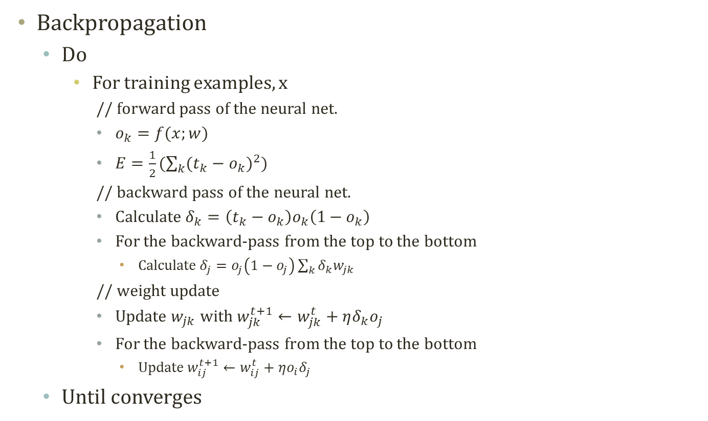






Detour: Backpropagation
$$o_{k}$$
…
$$o_{…}$$
…
$$o_{…}$$
$$o_{k}=σ({net}_{k})$$
$${net}_{k}=\sum_{j}{w_{jk}o_{j}}$$
$$w_{jk}$$
Backpropagation
Do
For training examples, x
// forward pass of the neural net.
$o_{k}=f(x;w)$
$E=\frac{1}{2}(\sum_{k}{{(t_{k}−o_{k})}^{2}})$
// backward pass of the neural net.
Calculate $δ_{k}=\left(t_{k}−o_{k}\right)o_{k}\left(1−o_{k}\right)$
For the backward-pass from the top to the bottom
Calculate $δ_{j}=o_{j}\left(1−o_{j}\right)\sum_{k}{δ_{k}w_{jk}}$
// weight update
Update $w_{jk}$ with $w_{jk}^{t+1}←w_{jk}^{t}+ηδ_{k}o_{j}$
For the backward-pass from the top to the bottom
Update $w_{ij}^{t+1}←w_{ij}^{t}+ηo_{i}δ_{j}$
Until converges
$$o_{j}$$
…
$$o_{…}$$
…
$$o_{…}$$
$$o_{j}=σ({net}_{j})$$
$${net}_{j}=\sum_{i}{w_{ij}o_{i}}$$
$$w_{ij}$$
$$o_{i}$$
…
$$o_{…}$$
…
$$o_{…}$$

Slide 5
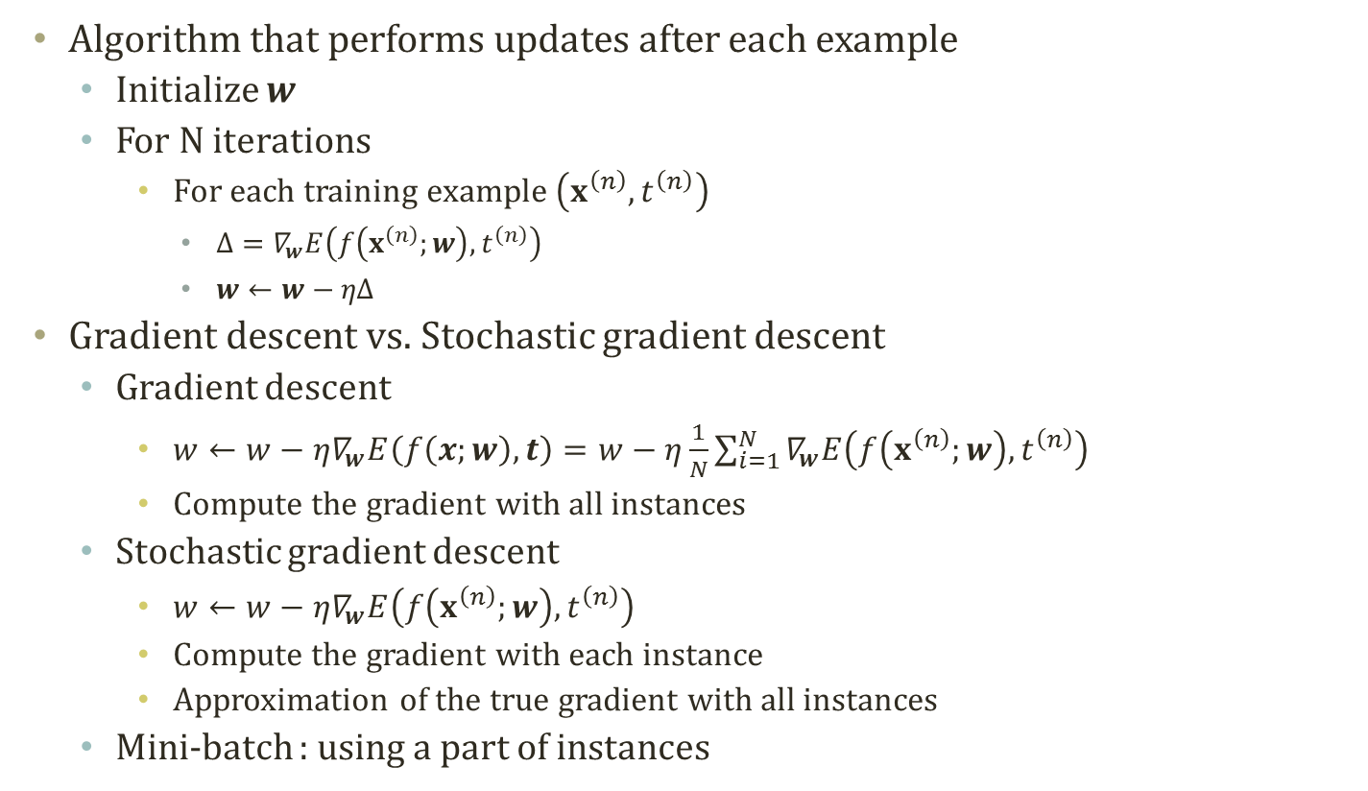
Detour: Stochastic Gradient Descent
Algorithm that performs updates after each example
Initialize $w$
For N iterations
For each training example $\left(x^{\left(n\right)},t^{\left(n\right)}\right)$
$Δ=∇_{w}E\left(f\left(x^{\left(n\right)};w\right),t^{\left(n\right)}\right)$
$w←w−ηΔ$
Gradient descent vs. Stochastic gradient descent
Gradient descent
$w←w−η∇_{w}E\left(f\left(x;w\right),t\right)=w−η\frac{1}{N}\sum_{i=1}^{N}{∇_{w}E\left(f\left(x^{\left(n\right)};w\right),t^{\left(n\right)}\right)}$
Compute the gradient with all instances
Stochastic gradient descent
$w←w−η∇_{w}E\left(f\left(x^{\left(n\right)};w\right),t^{\left(n\right)}\right)$
Compute the gradient with each instance
Approximation of the true gradient with all instances
Mini-batch : using a part of instances
Notes:
Theta를 업데이트할 때마다 overfitting되는 theta가 outputing되는 것을 방지하기 위함.
배치 이터레이션이면 배치 업데이트시 regularization term이 포함될 것.
학습 데이터에 대한 오차를 최소화

Slide 6
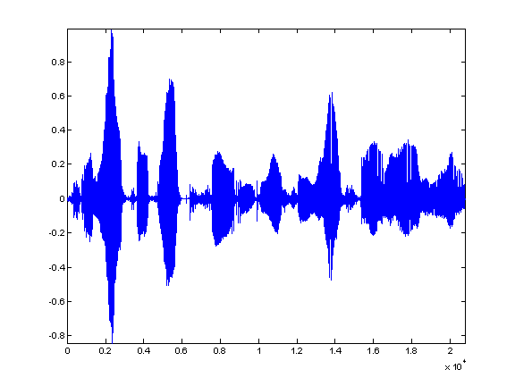

Neural Networks for Various Domains
Previous structure : Fully connected networks
Recent advances in neural networks
Computer vision
Language models
Application domain influences network structures
Convolutional structure utilizing localized connections
Recurrent structure utilizing chain connections
Speech Recognition
Layer L+1
Layer L+1
Airplane
Layer L
Layer L
Layer L+1
Layer L
Image Classification
Object Recognition
Time T
Time T+1

Slide 7
Example : Computer Vision
Vision problem characteristics
High dimensional inputs
150 X 100 pixels = 15000 pixels
15000 pixels X 3 RGB channels = 45000 real value inputs
2D topology of pixels for images and 3D topology of pixels for video
Need to handle invariance
Rotation, Translation, Scale…
Convolutional neural networks mitigates these characteristics
Local connectivity
Convolution
Pooling
100 pixels
150 pixels

Slide 8
Local Connectivity
Receptive Field
Use a local connectivity of hidden units
Each hidden unit is connected to only to a sub-region of the input images
Connected to all channels : 1 channel of grayscale and 3 RGB channel of color images
Advantages of local connectivity
# of a fully connected layer >>> # of a sparsely connected Layer
More number of parameters to optimize
More data, more difficulties in learning
How to sparsely connect?
Utilizing the 2D topologies : Receptive field
Layer L
Layer L+1

Slide 9
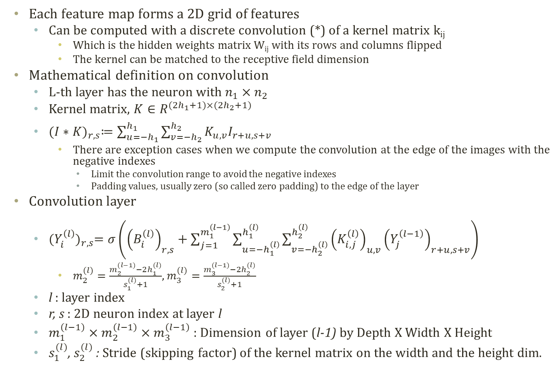
Convolution Layer
Each feature map forms a 2D grid of features
Can be computed with a discrete convolution (*) of a kernel matrix k_{ij}
Which is the hidden weights matrix W_{ij} with its rows and columns flipped
The kernel can be matched to the receptive field dimension
Mathematical definition on convolution
L-th layer has the neuron with $n_{1}×n_{2}$
Kernel matrix, $K∈R^{(2h_{1}+1)×(2h_{2}+1)}$
${(I∗K)}_{r,s}≔\sum_{u=−h_{1}}^{h_{1}}{\sum_{v=−h_{2}}^{h_{2}}{K_{u,v}I_{r+u,s+v}}}$
There are exception cases when we compute the convolution at the edge of the images with the negative indexes
Limit the convolution range to avoid the negative indexes
Padding values, usually zero (so called zero padding) to the edge of the layer
Convolution layer
${(Y_{i}^{\left(l\right)})}_{r,s}=σ\left({\left(B_{i}^{\left(l\right)}\right)}_{r,s}+\sum_{j=1}^{m_{1}^{\left(l−1\right)}}{\sum_{u=−h_{1}^{\left(l\right)}}^{h_{1}^{\left(l\right)}}{\sum_{v=−h_{2}^{\left(l\right)}}^{h_{2}^{\left(l\right)}}{{\left(K_{i,j}^{\left(l\right)}\right)}_{u,v}{\left(Y_{j}^{\left(l−1\right)}\right)}_{r+u,s+v}}}}\right)$
$m_{2}^{(l)}=\frac{m_{2}^{(l−1)}−2h_{1}^{(l)}}{s_{1}^{(l)}+1}$, $m_{3}^{(l)}=\frac{m_{3}^{(l−1)}−2h_{2}^{(l)}}{s_{2}^{(l)}+1}$
l : layer index
r, s : 2D neuron index at layer l
$m_{1}^{\left(l−1\right)}×m_{2}^{\left(l−1\right)}×m_{3}^{\left(l−1\right)}$ : Dimension of layer (l-1) by Depth X Width X Height
$s_{1}^{(l)}$, $s_{2}^{(l)}$ : Stride (skipping factor) of the kernel matrix on the width and the height dim.

Slide 10
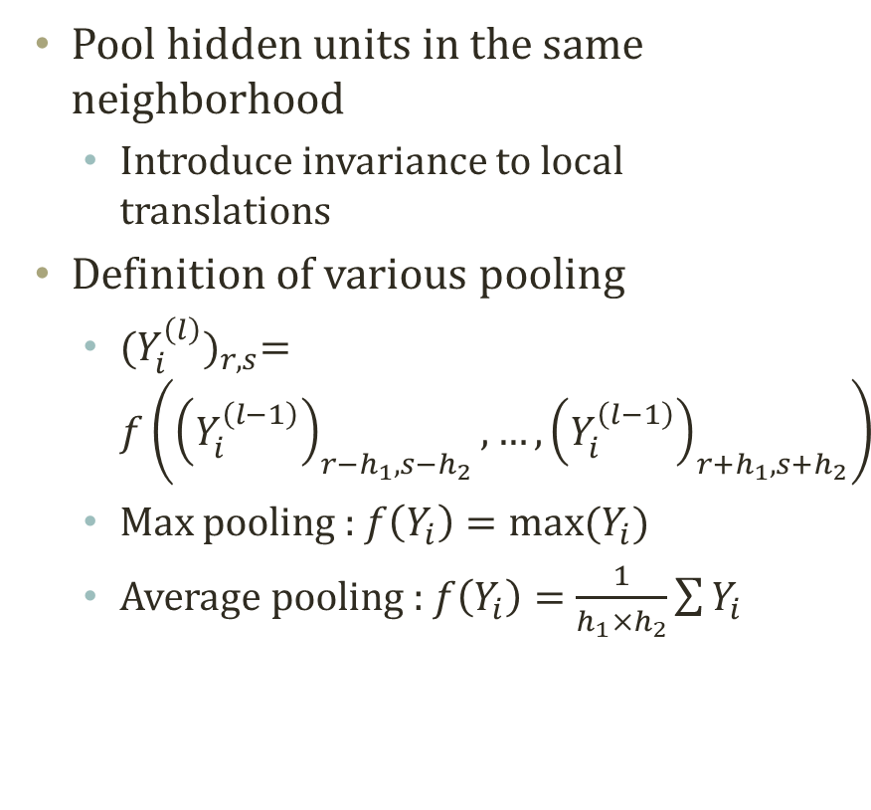
Pooling Layer
Sub-Sampling
Pool hidden units in the same neighborhood
Introduce invariance to local translations
Definition of various pooling
${(Y_{i}^{\left(l\right)})}_{r,s}=f\left({\left(Y_{i}^{\left(l−1\right)}\right)}_{r−h_{1},s−h_{2}},…,{\left(Y_{i}^{\left(l−1\right)}\right)}_{r+h_{1},s+h_{2}}\right)$
Max pooling : $f\left(Y_{i}\right)=max⁡(Y_{i})$
Average pooling : $f\left(Y_{i}\right)=\frac{1}{h_{1}×h_{2}}\sum{Y_{i}}$
Layer L
Layer L+1

Slide 11
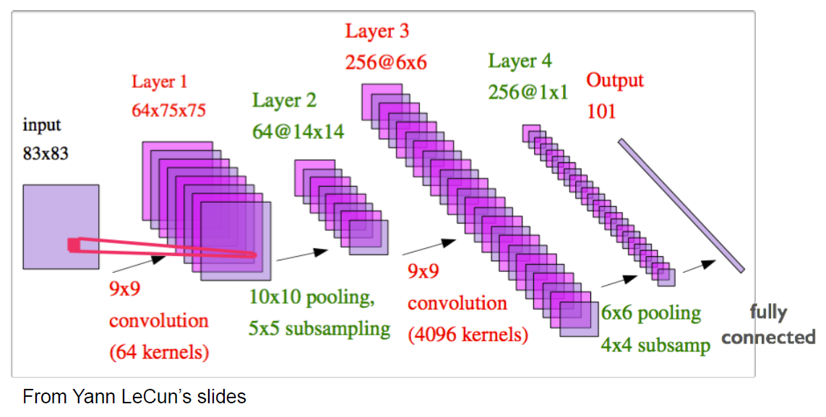
Example of Convolution Neural Network
Should be able to read the structure presented as the above diagram
Convolution layer, pooling layer, fully connected layer
Require to use diverse kernels and carefully calibrated hyperparameters
Still learnable with the back-propagation with some techniques

Slide 12
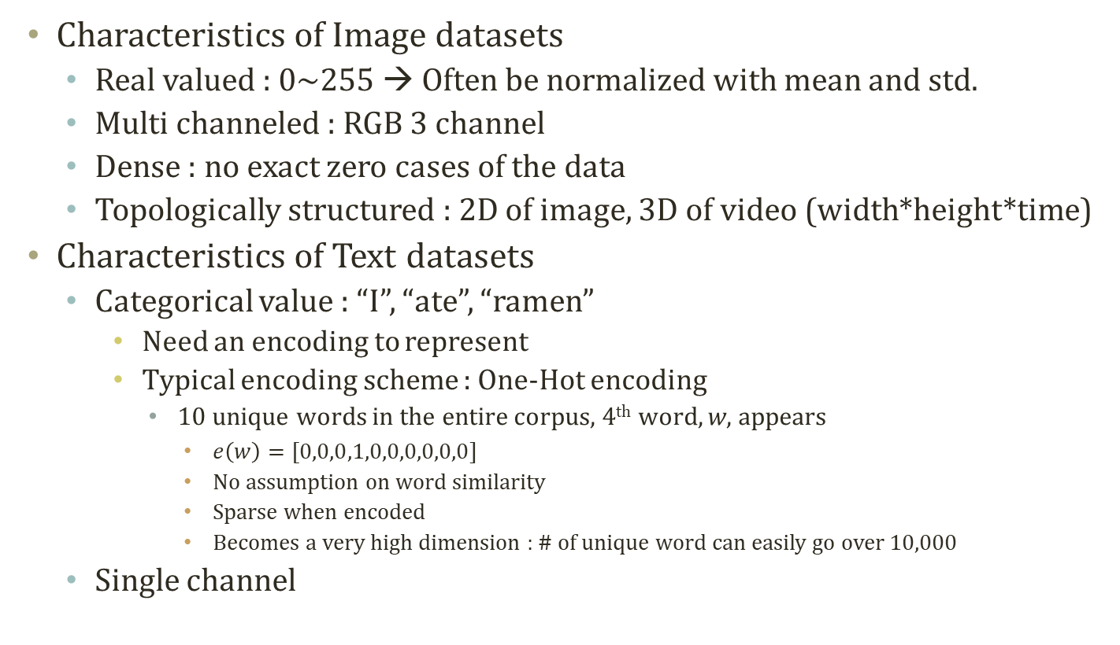
Detour: Handling Datasets
Characteristics of Image datasets
Real valued : 0~255 → Often be normalized with mean and std.
Multi channeled : RGB 3 channel
Dense : no exact zero cases of the data
Topologically structured : 2D of image, 3D of video (width*height*time)
Characteristics of Text datasets
Categorical value : “I”, “ate”, “ramen”
Need an encoding to represent
Typical encoding scheme : One-Hot encoding
10 unique words in the entire corpus, 4th word, w, appears
$e\left(w\right)=[0,0,0,1,0,0,0,0,0,0]$
No assumption on word similarity
Sparse when encoded
Becomes a very high dimension : # of unique word can easily go over 10,000
Single channel

Slide 13





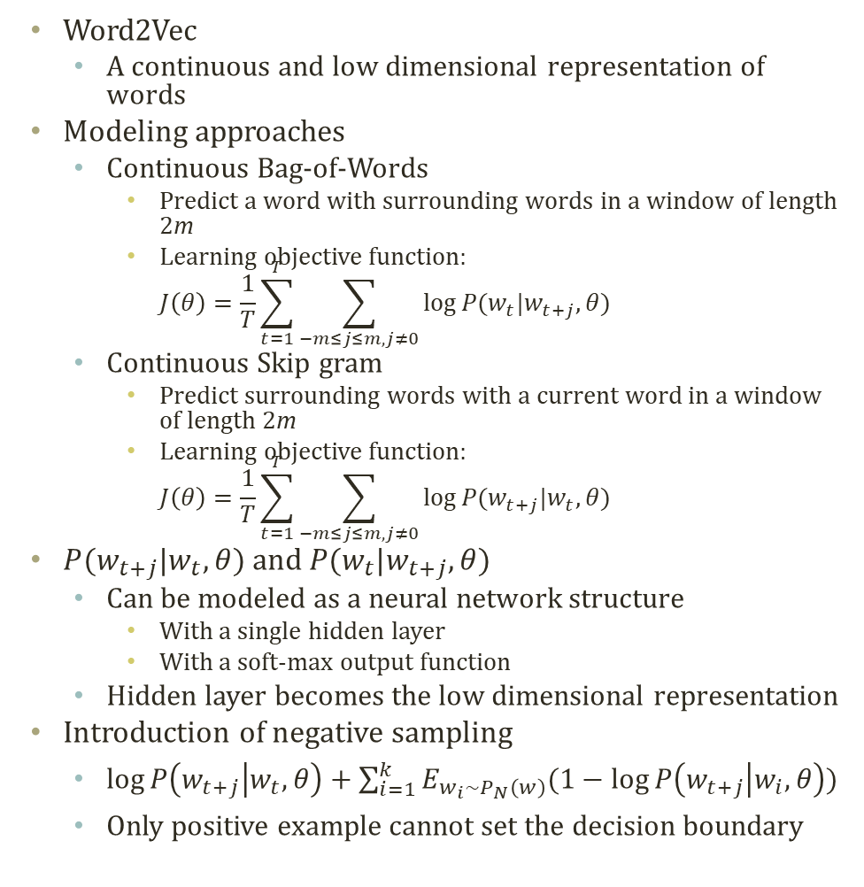







Detour: Word2Vec
$$w_{t−1}$$
Weight Sharing!
Word2Vec
A continuous and low dimensional representation of words
Modeling approaches
Continuous Bag-of-Words
Predict a word with surrounding words in a window of length 2m
Learning objective function: $J\left(θ\right)=\frac{1}{T}\sum_{t=1}^{T}{\sum_{−m≤j≤m,j≠0}{log⁡P(w_{t}|w_{t+j},θ)}}$
Continuous Skip gram
Predict surrounding words with a current word in a window of length 2m
Learning objective function: $J\left(θ\right)=\frac{1}{T}\sum_{t=1}^{T}{\sum_{−m≤j≤m,j≠0}{log⁡P(w_{t+j}|w_{t},θ)}}$
$P(w_{t+j}|w_{t},θ)$ and $P(w_{t}|w_{t+j},θ)$
Can be modeled as a neural network structure
With a single hidden layer
With a soft-max output function
Hidden layer becomes the low dimensional representation
Introduction of negative sampling
$\log{P\left(w_{t+j} | w_{t},θ\right)}+\sum_{i=1}^{k}{E_{w_{i}\sim P_{N}\left(w\right)}(1−\log{P\left(w_{t+j} | w_{i},θ\right)})}$
Only positive example cannot set the decision boundary
$$W_{1,V×N}$$
$$w_{t}$$
H
$$W_{2,N×V}$$
$$w_{t+1}$$
$$W_{1,V×N}$$
N dim.
$$w_{t−1}$$
V dim.
$$w_{t}$$
$$W_{2,N×V}$$
H
$$W_{1,V×N}$$
$$w_{t+1}$$
N dim.
$$W_{3,N×V}$$
V dim.
V dim.

Slide 14
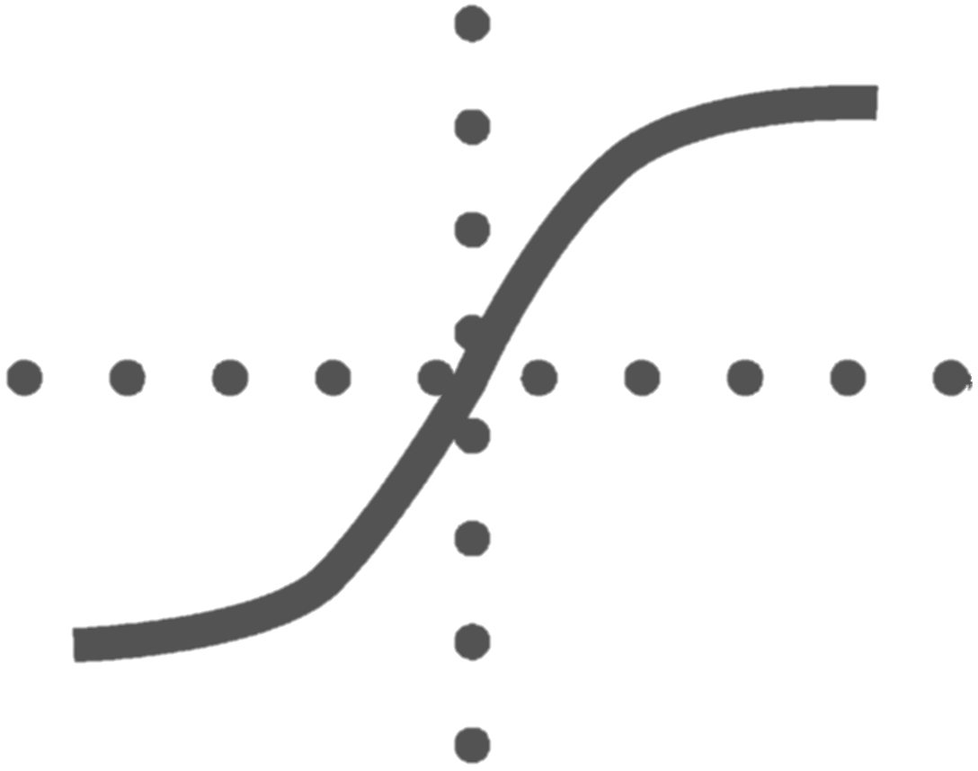








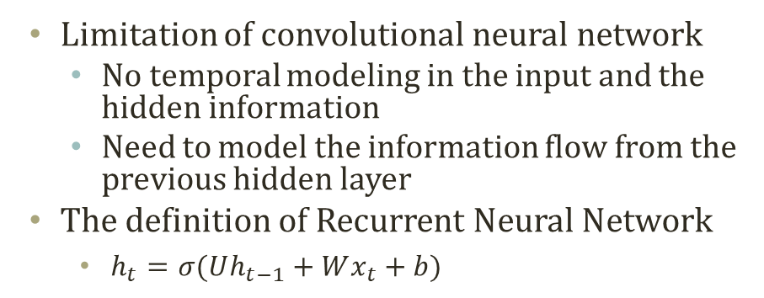
































Modeling Temporal Data with NN
Limitation of convolutional neural network
No temporal modeling in the input and the hidden information
Need to model the information flow from the previous hidden layer
The definition of Recurrent Neural Network
$h_{t}=σ(Uh_{t−1}+Wx_{t}+b)$
O_{t-1}
O_{t}
W₂
W₂
U₁
U₁
U₁
H_{t-1}
H_{t}
W₁
W₁
X_{t-1}
X_{t}
$$f(x)$$
$$f(x)$$
$$f(x)$$
$$⋅⋅⋅$$
$$⋅⋅⋅$$
$$⋅⋅⋅$$
$$W^{\left(3\right)}$$
$$W^{\left(2\right)}$$
$$W^{\left(2\right)}$$
$$h^{\left(t+1,1\right)}\left(x\right)$$
$$h^{\left(2\right)}\left(x\right)$$
$$⋅⋅⋅$$
$$⋅⋅⋅$$
$$U^{\left(1\right)}$$
$$⋅⋅⋅$$
$$⋅⋅⋅$$
$$W^{\left(2\right)}$$
$$h^{\left(1\right)}\left(x\right)$$
$$⋅⋅⋅$$
$$⋅⋅⋅$$
$$⋅⋅⋅$$
$$⋅⋅⋅$$
$$h^{\left(t,1\right)}\left(x\right)$$
$$W^{\left(1\right)}$$
$$W^{\left(1\right)}$$
$$W^{\left(1\right)}$$
$$x_{1}$$
$$⋅⋅⋅$$
$$x_{j}$$
$$⋅⋅⋅$$
$$x_{d}$$
$$x_{t,1}$$
$$⋅⋅⋅$$
$$x_{t,j}$$
$$⋅⋅⋅$$
$$x_{t,d}$$
$$x_{t+1,1}$$
$$⋅⋅⋅$$
$$x_{t+1,j}$$
$$⋅⋅⋅$$
$$x_{t+1,d}$$

Slide 15
Variant of Recurrent Neural Network
Bidirectional RNN for influence from X_{t+1} to X_{t}
Deep RNN for further complex modeling on X and H
Sequence-to-Sequence RNN when generate an output after the whole sequence input
O_{t-1}
O_{t}
O_{t-1}
O_{t}
W₂
W₂
W₂
W₂
U_{1,R}
U_{1,R}
U_{1,R}
U₁
U₁
U₁
H_{t-1}
H_{t}
H_{t-1}
H_{t}
U_{1,L}
U_{1,L}
U_{1,L}
W₁
W₁
W₁
W₁
X_{t-1}
X_{t}
X_{t-1}
X_{t}
Bidirectional Recurrent Neural Network
Recurrent Neural Network
O_{t-1}
O_{t}
O₁
O₂
W₃
W₃
W₃
W₃
U₂
U₂
U₂
U₂
U₂
U₂
U₂
H_{t-1,2}
H_{t,2}
H_{t+1,2}
H_{t+2,2}
H_{t-1,2}
H_{t,2}
U₁
W₂
U₁
W₂
U₁
W₂
U₁
W₂
U₁
W₂
U₁
W₂
U₁
H_{t-1,1}
H_{t,1}
H_{t+1,1}
H_{t+2,1}
H_{t-1,1}
H_{t,1}
W₁
W₁
W₁
W₁
W₁
W₁
X_{t-1}
X_{t}
X_{EOS}
O₁
X_{t-1}
X_{t}
Deep Recurrent Neural Network
Deep Sequence-to-Sequence Recurrent Neural Network

Slide 16
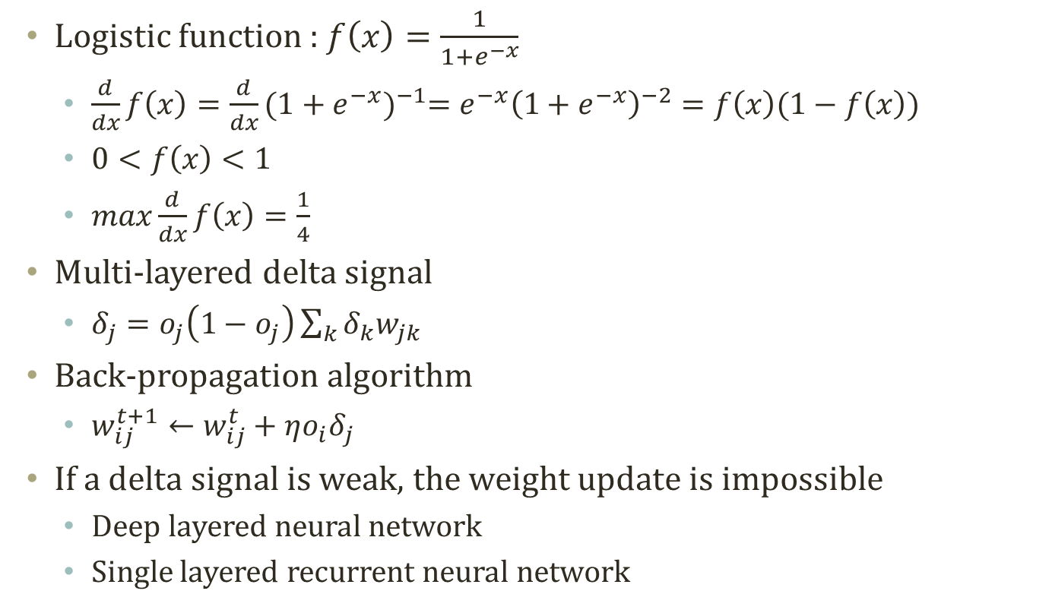
Vanishing Gradient Problem
Logistic function : $f\left(x\right)=\frac{1}{1+e^{−x}}$
$\frac{d}{dx}f\left(x\right)=\frac{d}{dx}{(1+e^{−x})}^{−1}=e^{−x}{\left(1+e^{−x}\right)}^{−2}=f\left(x\right)(1−f\left(x\right))$
$0<f\left(x\right)<1$
$max\frac{d}{dx}f\left(x\right)=\frac{1}{4}$
Multi-layered delta signal
$δ_{j}=o_{j}\left(1−o_{j}\right)\sum_{k}{δ_{k}w_{jk}}$
Back-propagation algorithm
$w_{ij}^{t+1}←w_{ij}^{t}+ηo_{i}δ_{j}$
If a delta signal is weak, the weight update is impossible
Deep layered neural network
Single layered recurrent neural network

Slide 17







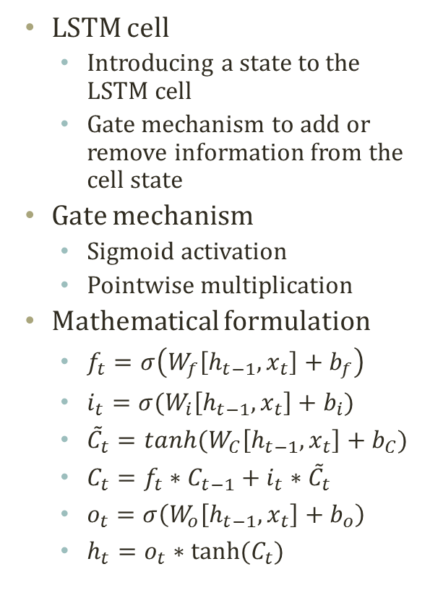










Long Short Term Memory
$$h_{t}$$
LSTM cell
Introducing a state to the LSTM cell
Gate mechanism to add or remove information from the cell state
Gate mechanism
Sigmoid activation
Pointwise multiplication
Mathematical formulation
$f_{t}=σ\left(W_{f}\left[h_{t−1},x_{t}\right]+b_{f}\right)$
$i_{t}=σ(W_{i}\left[h_{t−1},x_{t}\right]+b_{i})$
${\tilde{C}}_{t}=tanh(W_{C}\left[h_{t−1},x_{t}\right]+b_{C})$
$C_{t}=f_{t}∗C_{t−1}+i_{t}∗{\tilde{C}}_{t}$
$o_{t}=σ\left(W_{o}\left[h_{t−1},x_{t}\right]+b_{o}\right)$
$h_{t}=o_{t}∗tanh⁡(C_{t})$
$$C_{t−1}$$
$$C_{t}$$
$$×$$
$$+$$
tanh
$$×$$
$$f_{t}$$
$$i_{t}$$
$$×$$
$${\tilde{C}}_{t}$$
$$o_{t}$$
$$σ$$
$$σ$$
tanh
$$σ$$
$$h_{t−1}$$
$$h_{t}$$
$$x_{t}$$
Hochreiter, Sepp, and Jürgen Schmidhuber. "Long short-term memory." Neural computation 9.8 (1997): 1735-1780.

Slide 18
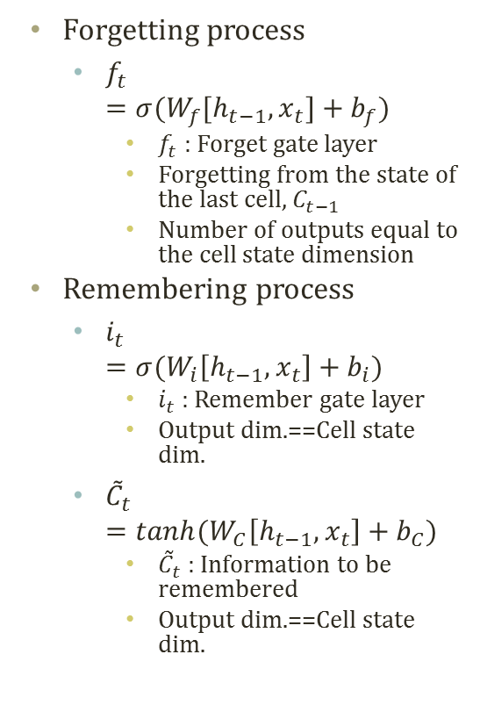
Long Short Term Memory
$$h_{t}$$
Forgetting process
$f_{t}$ $=σ(W_{f}[h_{t−1},x_{t}]+b_{f})$
$f_{t}$ : Forget gate layer
Forgetting from the state of the last cell, $C_{t−1}$
Number of outputs equal to the cell state dimension
Remembering process
$i_{t}$ $=σ(W_{i}\left[h_{t−1},x_{t}\right]+b_{i})$
$i_{t}$ : Remember gate layer
Output dim.==Cell state dim.
${\tilde{C}}_{t}$ $=tanh(W_{C}\left[h_{t−1},x_{t}\right]+b_{C})$
${\tilde{C}}_{t}$ : Information to be remembered
Output dim.==Cell state dim.
$$C_{t−1}$$
$$C_{t}$$
$$×$$
$$+$$
tanh
$$×$$
$$f_{t}$$
$$i_{t}$$
$$×$$
$${\tilde{C}}_{t}$$
$$o_{t}$$
$$σ$$
$$σ$$
tanh
$$σ$$
$$h_{t−1}$$
$$h_{t}$$
$$x_{t}$$
Hochreiter, Sepp, and Jürgen Schmidhuber. "Long short-term memory." Neural computation 9.8 (1997): 1735-1780.

Slide 19
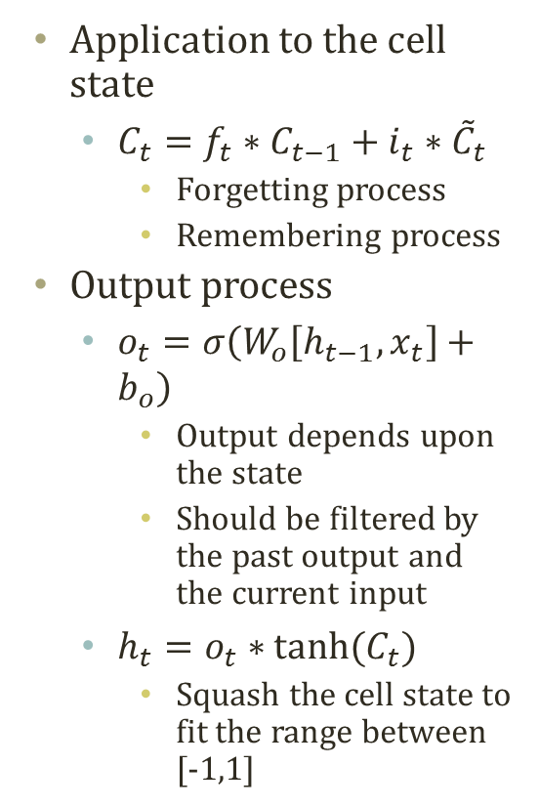
Long Short Term Memory
$$h_{t}$$
Application to the cell state
$C_{t}=f_{t}∗C_{t−1}+i_{t}∗{\tilde{C}}_{t}$
Forgetting process
Remembering process
Output process
$o_{t}=σ\left(W_{o}\left[h_{t−1},x_{t}\right]+b_{o}\right)$
Output depends upon the state
Should be filtered by the past output and the current input
$h_{t}=o_{t}∗tanh⁡(C_{t})$
Squash the cell state to fit the range between [-1,1]
$$C_{t−1}$$
$$C_{t}$$
$$×$$
$$+$$
tanh
$$×$$
$$f_{t}$$
$$i_{t}$$
$$×$$
$${\tilde{C}}_{t}$$
$$o_{t}$$
$$σ$$
$$σ$$
tanh
$$σ$$
$$h_{t−1}$$
$$h_{t}$$
$$x_{t}$$
Hochreiter, Sepp, and Jürgen Schmidhuber. "Long short-term memory." Neural computation 9.8 (1997): 1735-1780.

Slide 20
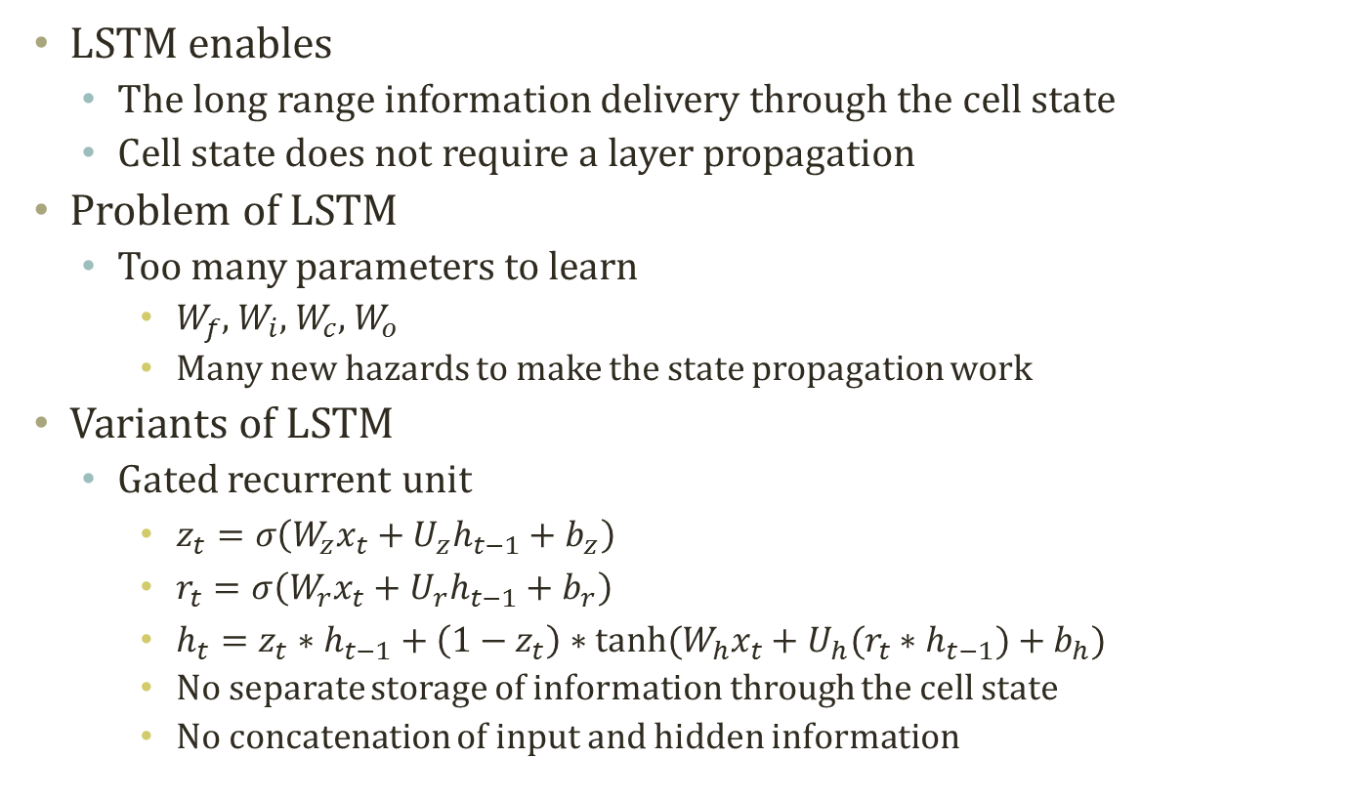
Pros and Cons of LSTM
LSTM enables
The long range information delivery through the cell state
Cell state does not require a layer propagation
Problem of LSTM
Too many parameters to learn
$W_{f}$, $W_{i}$, $W_{c}$, $W_{o}$
Many new hazards to make the state propagation work
Variants of LSTM
Gated recurrent unit
$z_{t}=σ\left(W_{z}x_{t}+U_{z}h_{t−1}+b_{z}\right)$
$r_{t}=σ\left(W_{r}x_{t}+U_{r}h_{t−1}+b_{r}\right)$
$h_{t}=z_{t}∗h_{t−1}+\left(1−z_{t}\right)∗tanh⁡(W_{h}x_{t}+U_{h}(r_{t}∗h_{t−1})+b_{h})$
No separate storage of information through the cell state
No concatenation of input and hidden information

Slide 21
Techniques in neural networks

Slide 22
Many Techniques in Neural Networks
Neural network requires diverse techniques
Training process to facilitate the learning
Batch normalization
Early stopping
Adversarial training
Momentum in optimization, adaptive learning rate, gradient checking …
Structure to facilitate the learning
Attention network
Highway network
Dropout….
Some are originated from experiments, and others are motivated by theory
A few found to be useful by experiments, and later, they are revealed to be meaningful, theoretically
Inference is limited to the stochastic gradient descent

Slide 23
Model Selection
Training processes
Given a dataset, D
Divide D into three datasets
Training set : D^{train}
To infer the parameter of the model to train
Validation set : D^{valid}
To search the hyper-parameter
Hidden layer size, learning rate, number of iterations
Test set : D^{test}
Actual testing
In the real world,
Train the model with the training and the validation set
Deployment domain requires adaptations
Training : development phase
Validation : deployment phase
Test the model with the testing set
Evaluate the actual performance after the deployment

Slide 24
Early Stopping
Neural network model is naturally complex with many parameters
Very easy to overfit
Stop the fitting before the model overfits
Training : the model parameter inference
Validation : early stopping point check
Loss
Function
Underfitting
Overfitting
Validation
Training
Training Iterations

Slide 25
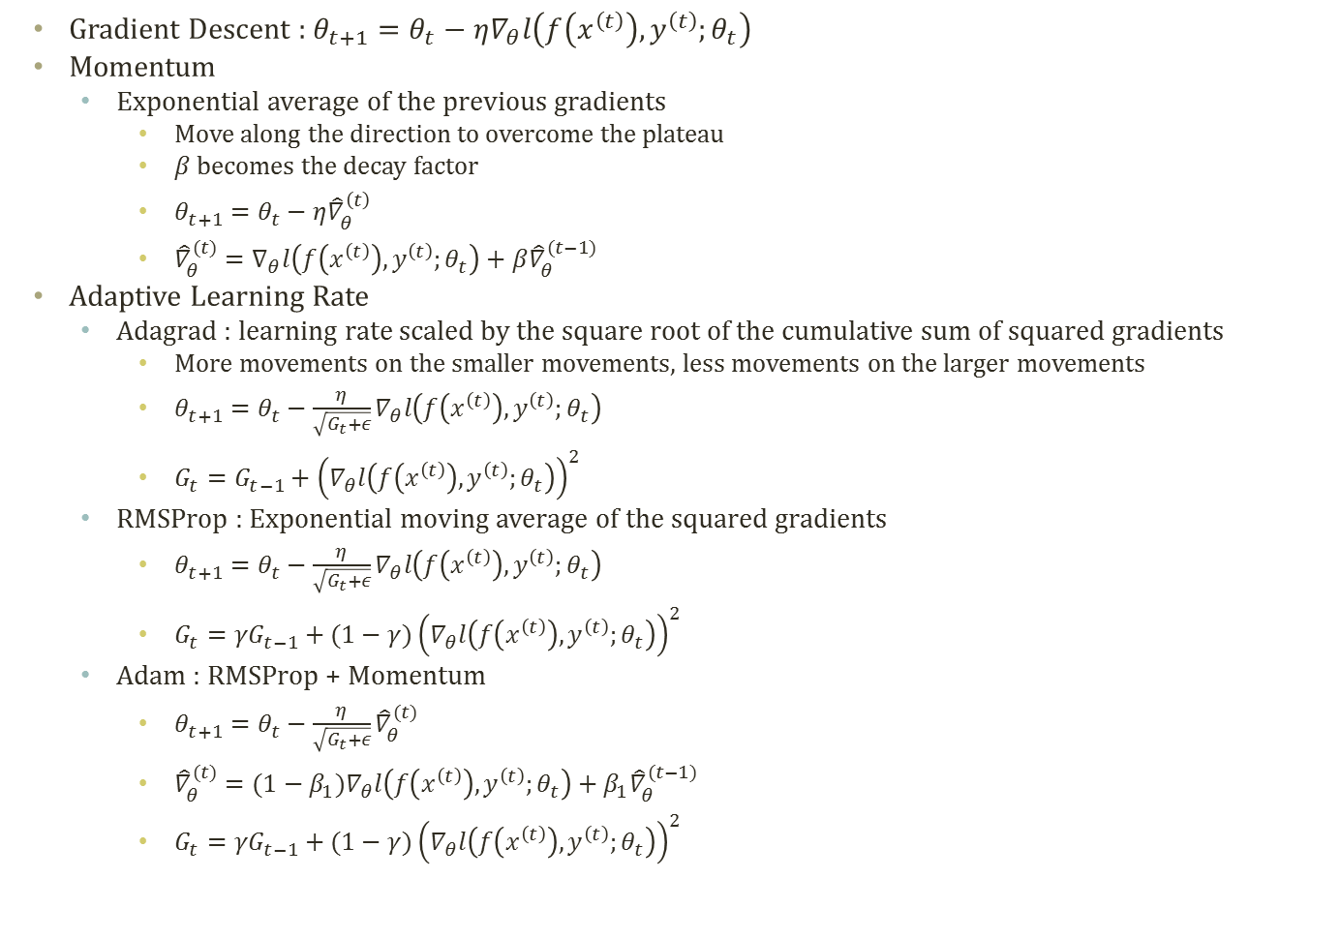
Momentum and Adaptive Learning Rate
Gradient Descent : $θ_{t+1}=θ_{t}−η∇_{θ}l\left(f\left(x^{\left(t\right)}\right),y^{\left(t\right)};θ_{t}\right)$
Momentum
Exponential average of the previous gradients
Move along the direction to overcome the plateau
$β$ becomes the decay factor
$θ_{t+1}=θ_{t}−η{\hat{∇}}_{θ}^{\left(t\right)}$
${\hat{∇}}_{θ}^{(t)}=∇_{θ}l\left(f\left(x^{\left(t\right)}\right),y^{\left(t\right)};θ_{t}\right)+β{\hat{∇}}_{θ}^{(t−1)}$
Adaptive Learning Rate
Adagrad : learning rate scaled by the square root of the cumulative sum of squared gradients
More movements on the smaller movements, less movements on the larger movements
$θ_{t+1}=θ_{t}−\frac{η}{\sqrt{G_{t}+ε}}∇_{θ}l\left(f\left(x^{\left(t\right)}\right),y^{\left(t\right)};θ_{t}\right)$
$G_{t}=G_{t−1}+{\left(∇_{θ}l\left(f\left(x^{\left(t\right)}\right),y^{\left(t\right)};θ_{t}\right)\right)}^{2}$
RMSProp : Exponential moving average of the squared gradients
$θ_{t+1}=θ_{t}−\frac{η}{\sqrt{G_{t}+ε}}∇_{θ}l\left(f\left(x^{\left(t\right)}\right),y^{\left(t\right)};θ_{t}\right)$
$G_{t}={γG}_{t−1}+(1−γ){\left(∇_{θ}l\left(f\left(x^{\left(t\right)}\right),y^{\left(t\right)};θ_{t}\right)\right)}^{2}$
Adam : RMSProp + Momentum
$θ_{t+1}=θ_{t}−\frac{η}{\sqrt{G_{t}+ε}}{\hat{∇}}_{θ}^{(t)}$
${\hat{∇}}_{θ}^{(t)}=(1−β_{1})∇_{θ}l\left(f\left(x^{\left(t\right)}\right),y^{\left(t\right)};θ_{t}\right)+β_{1}{\hat{∇}}_{θ}^{(t−1)}$
$G_{t}={γG}_{t−1}+(1−γ){\left(∇_{θ}l\left(f\left(x^{\left(t\right)}\right),y^{\left(t\right)};θ_{t}\right)\right)}^{2}$

Slide 26
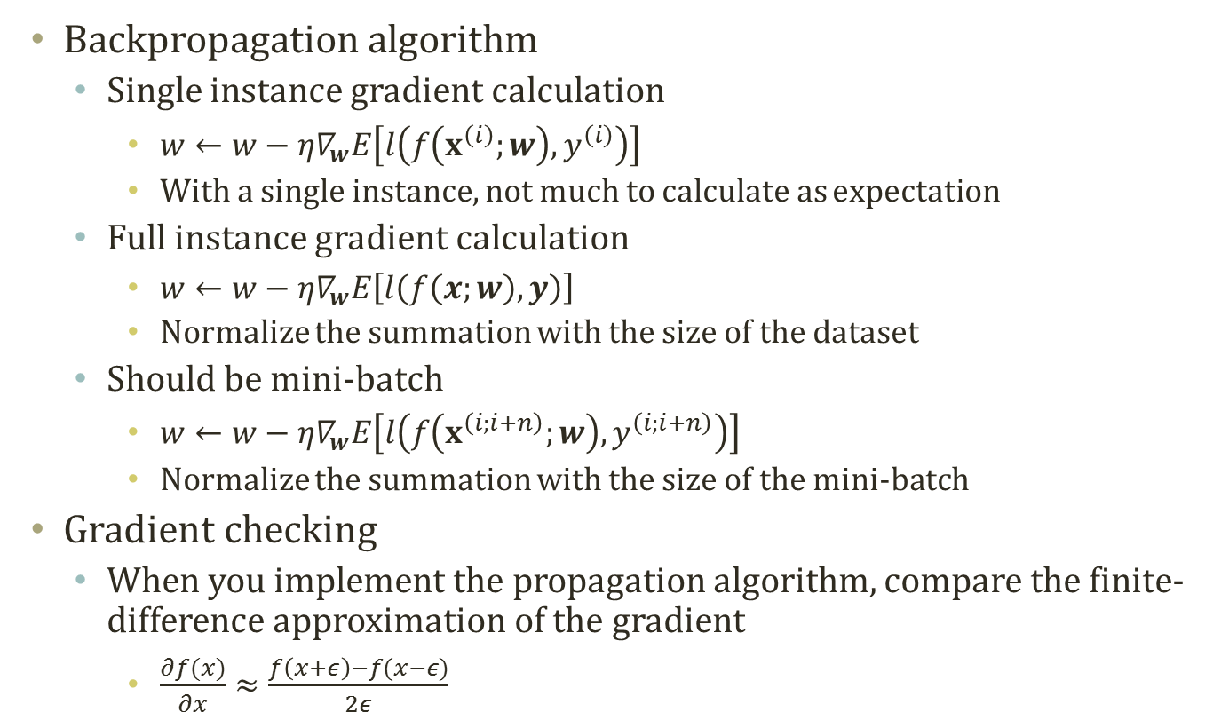
Mini-Batch and Gradient Checking
Backpropagation algorithm
Single instance gradient calculation
$w←w−η∇_{w}E\left[l\left(f\left(x^{\left(i\right)};w\right),y^{\left(i\right)}\right)\right]$
With a single instance, not much to calculate as expectation
Full instance gradient calculation
$w←w−η∇_{w}E\left[l\left(f\left(x;w\right),y\right)\right]$
Normalize the summation with the size of the dataset
Should be mini-batch
$w←w−η∇_{w}E\left[l\left(f\left(x^{\left(i;i+n\right)};w\right),y^{\left(i;i+n\right)}\right)\right]$
Normalize the summation with the size of the mini-batch
Gradient checking
When you implement the propagation algorithm, compare the finite-difference approximation of the gradient
$\frac{∂f(x)}{∂x}≈\frac{f\left(x+ε\right)−f(x−ε)}{2ε}$

Slide 27
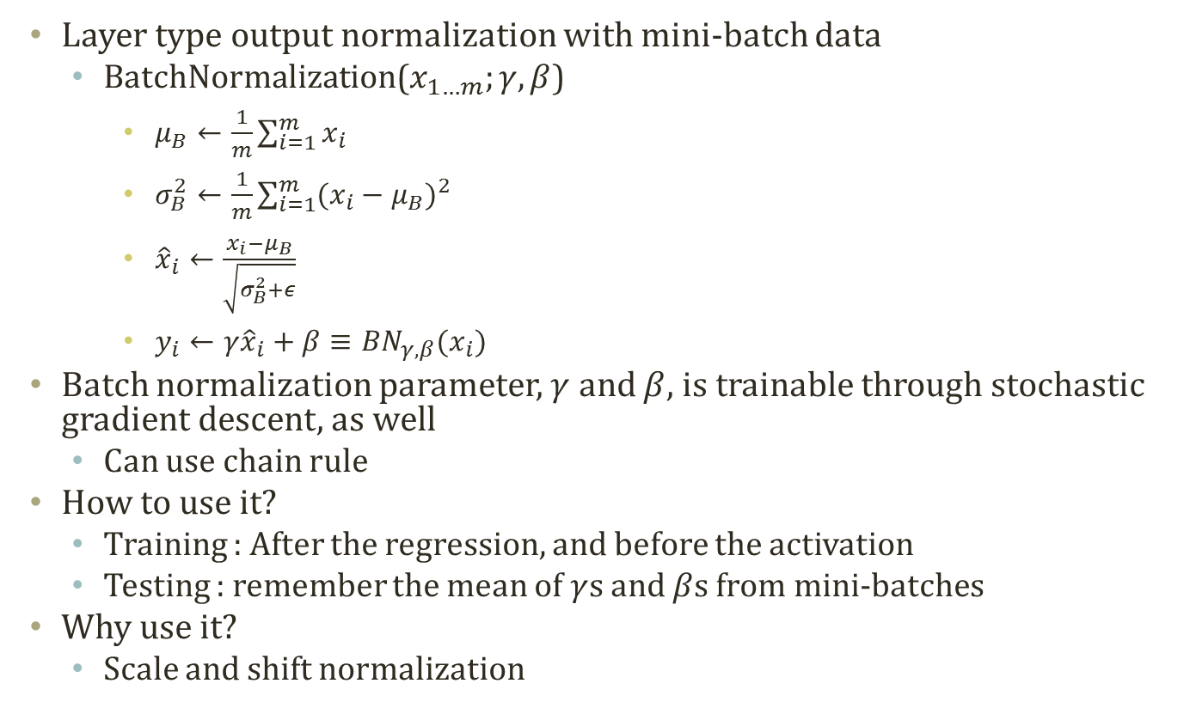
Batch Normalization
Layer type output normalization with mini-batch data
BatchNormalization($x_{1…m};γ,β$)
$μ_{B}←\frac{1}{m}\sum_{i=1}^{m}{x_{i}}$
$σ_{B}^{2}←\frac{1}{m}\sum_{i=1}^{m}{{(x_{i}−μ_{B})}^{2}}$
${\hat{x}}_{i}←\frac{x_{i}−μ_{B}}{\sqrt{σ_{B}^{2}+ε}}$
$y_{i}←γ{\hat{x}}_{i}+β≡{BN}_{γ,β}(x_{i})$
Batch normalization parameter, $γ$ and $β$, is trainable through stochastic gradient descent, as well
Can use chain rule
How to use it?
Training : After the regression, and before the activation
Testing : remember the mean of $γ$s and $β$s from mini-batches
Why use it?
Scale and shift normalization

Slide 28
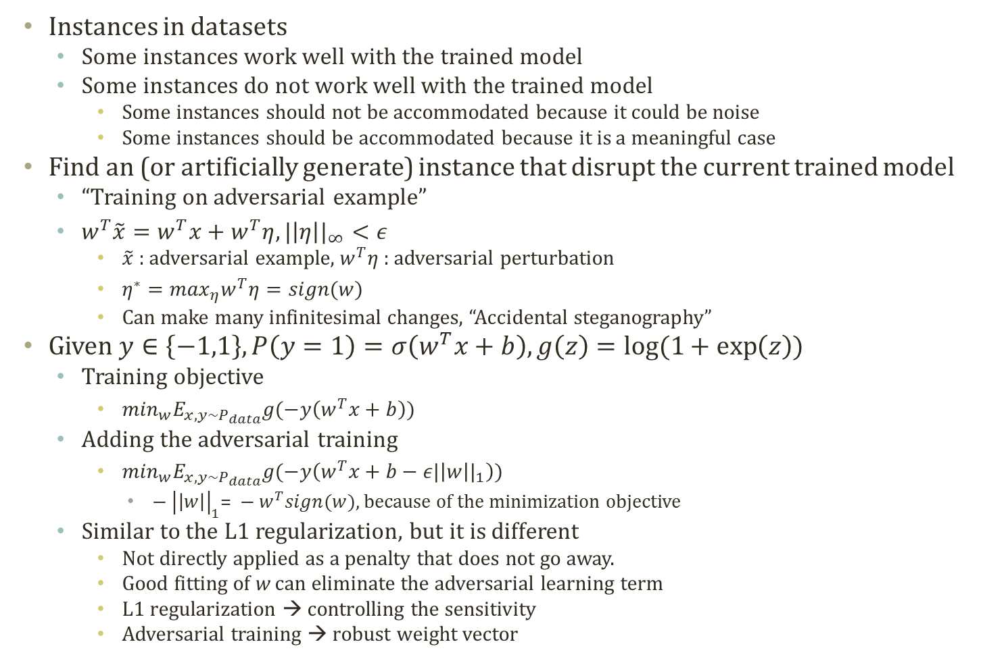
Adversarial Training
Instances in datasets
Some instances work well with the trained model
Some instances do not work well with the trained model
Some instances should not be accommodated because it could be noise
Some instances should be accommodated because it is a meaningful case
Find an (or artificially generate) instance that disrupt the current trained model
“Training on adversarial example”
$w^{T}\tilde{x}=w^{T}x+w^{T}η, {|\left|η\right||}_{∞}<ε$
$\tilde{x}$ : adversarial example, $w^{T}η$ : adversarial perturbation
$η^{∗}=\max_{η}w^{T}η=sign(w)$
Can make many infinitesimal changes, “Accidental steganography”
Given $y∈\left\{−1,1\right\}, P\left(y=1\right)=σ\left(w^{T}x+b\right), g\left(z\right)=log⁡(1+\exp\left(z\right))$
Training objective
$\min_{w}E_{x,y\sim P_{data}}g(−y\left(w^{T}x+b\right))$
Adding the adversarial training
$\min_{w}E_{x,y\sim P_{data}}g(−y\left(w^{T}x+b−ε{|\left|w\right||}_{1}\right))$
$− {\left|\left|w\right|\right|}_{1}\text{= }−w^{T}sign(w)$, because of the minimization objective
Similar to the L1 regularization, but it is different
Not directly applied as a penalty that does not go away.
Good fitting of w can eliminate the adversarial learning term
L1 regularization → controlling the sensitivity
Adversarial training → robust weight vector

Slide 29
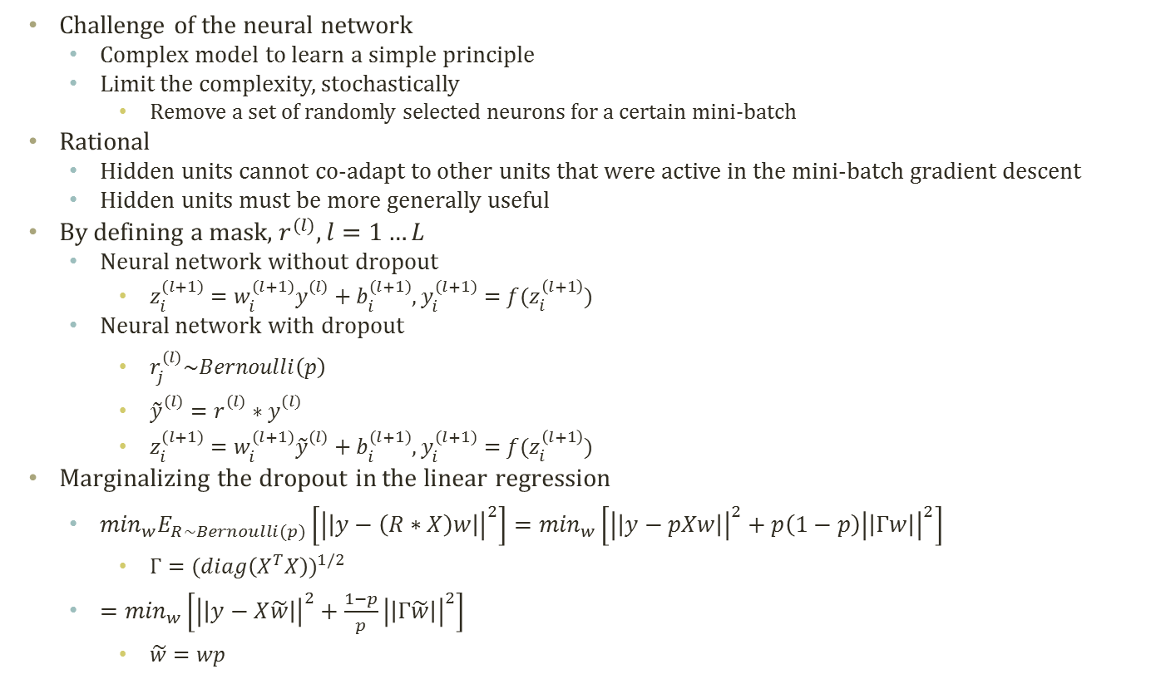
Dropout
Challenge of the neural network
Complex model to learn a simple principle
Limit the complexity, stochastically
Remove a set of randomly selected neurons for a certain mini-batch
Rational
Hidden units cannot co-adapt to other units that were active in the mini-batch gradient descent
Hidden units must be more generally useful
By defining a mask, $r^{(l)}, l=1…L$
Neural network without dropout
$z_{i}^{(l+1)}=w_{i}^{(l+1)}y_{}^{(l)}+b_{i}^{(l+1)}$, $y_{i}^{(l+1)}=f(z_{i}^{\left(l+1\right)})$
Neural network with dropout
$r_{j}^{(l)}\sim Bernoulli\left(p\right)$
${\tilde{y}}_{}^{(l)}=r_{}^{(l)}∗y_{}^{(l)}$
$z_{i}^{(l+1)}=w_{i}^{(l+1)}{\tilde{y}}_{}^{(l)}+b_{i}^{(l+1)}$, $y_{i}^{(l+1)}=f(z_{i}^{\left(l+1\right)})$
Marginalizing the dropout in the linear regression
$\min_{w}E_{R\sim Bernoulli(p)}\left[{\left|\left|y−\left(R∗X\right)w\right|\right|}^{2}\right]=\min_{w}\left[{\left|\left|y−pXw\right|\right|}^{2}+p\left(1−p\right){\left|\left|Γw\right|\right|}^{2}\right]$
$Γ={(diag\left(X^{T}X\right))}^{1/2}$
$=\min_{w}\left[{\left|\left|y−X\tilde{w}\right|\right|}^{2}+\frac{1−p}{p}{\left|\left|Γ\tilde{w}\right|\right|}^{2}\right]$
$\tilde{w}=wp$

Slide 30
Acknowledgements
This lecture is influenced and adopted materials from 10807 Topics in Deep Learning by Prof. Russ Salakhutdinov, Carnegie Mellon University.

